Slide 1
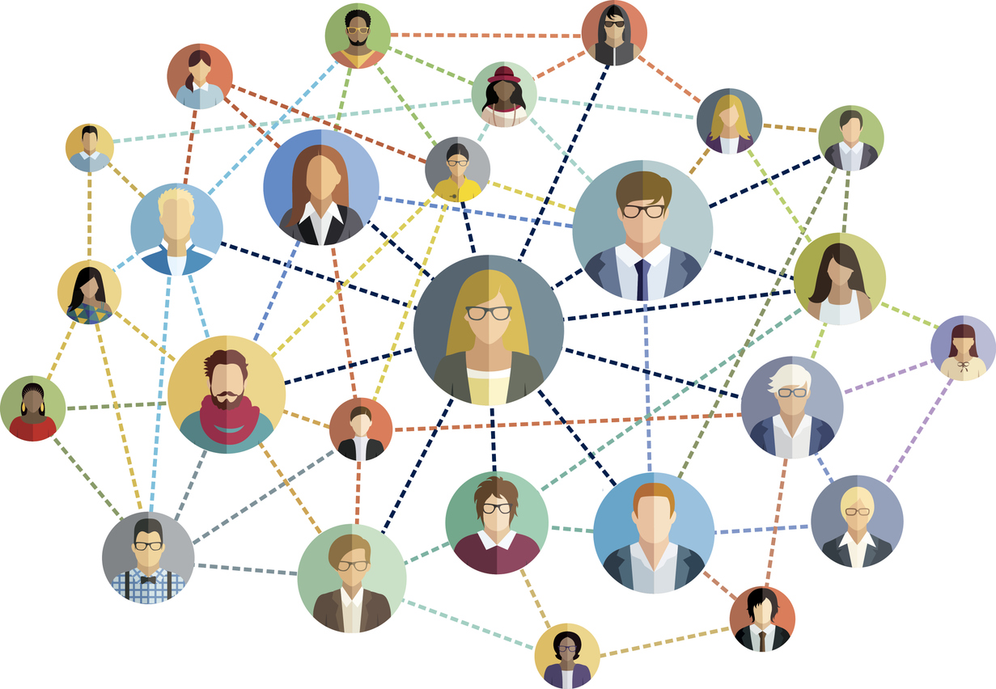
Care experienced peer network
This network supports care-experienced NHS staff of all ages.
Peer support plays a vital role in boosting well-being and connecting with others who have similar experiences can help build self-esteem, confidence, and lasting friendships.
This peer support group connects NHS staff with care experience to celebrate achievements and foster support.
Allies, including non-care-experienced colleagues who wish to support care leavers, are also welcome. It's important that past experiences won’t affect your future within the NHS.
Sign up to be part of this network, or if you have any questions, please email england.careexperiencedstaff@nhs.net
Only workspace managers can see member names and details unless you choose to participate in the discussion forum.

