Slide 1
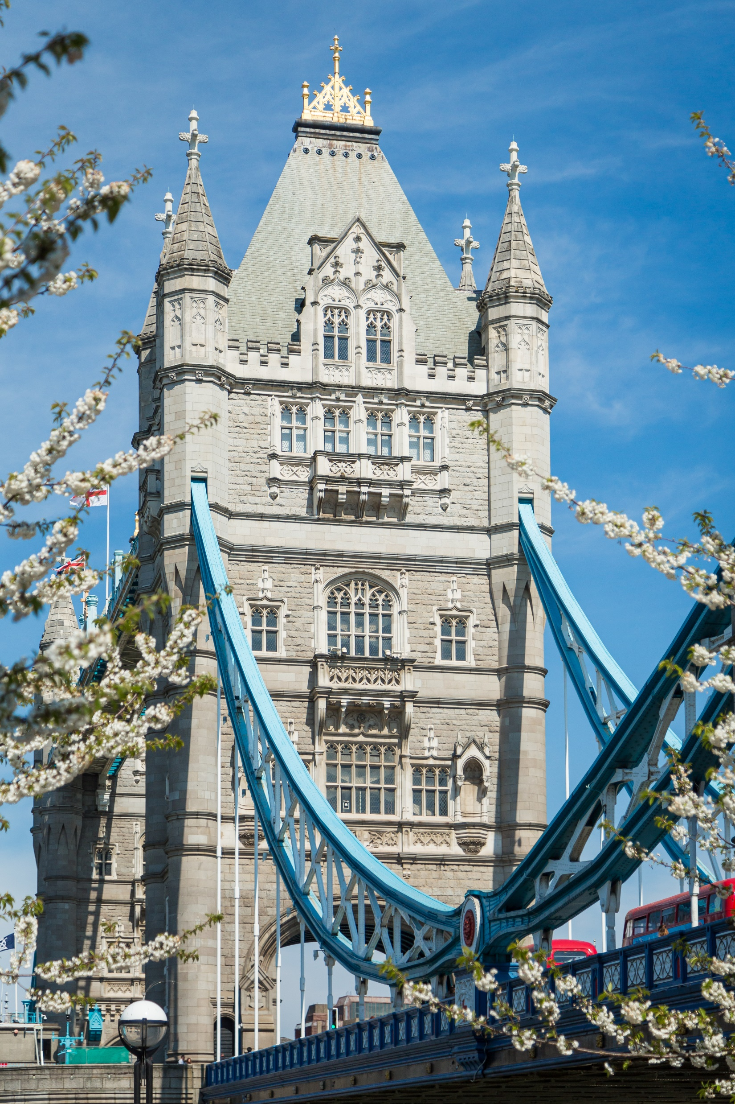
City Bridge Trust
Last updated: Feb 2022
Sandra Jones
Funding Manager

Slide 2
Vision: For London to be a city where all individuals and communities can thrive, especially those experiencing disadvantage and marginalisation
Mission: To reduce inequality and grow stronger, more resilient and thriving communities for a London that serves everyone.

Slide 3
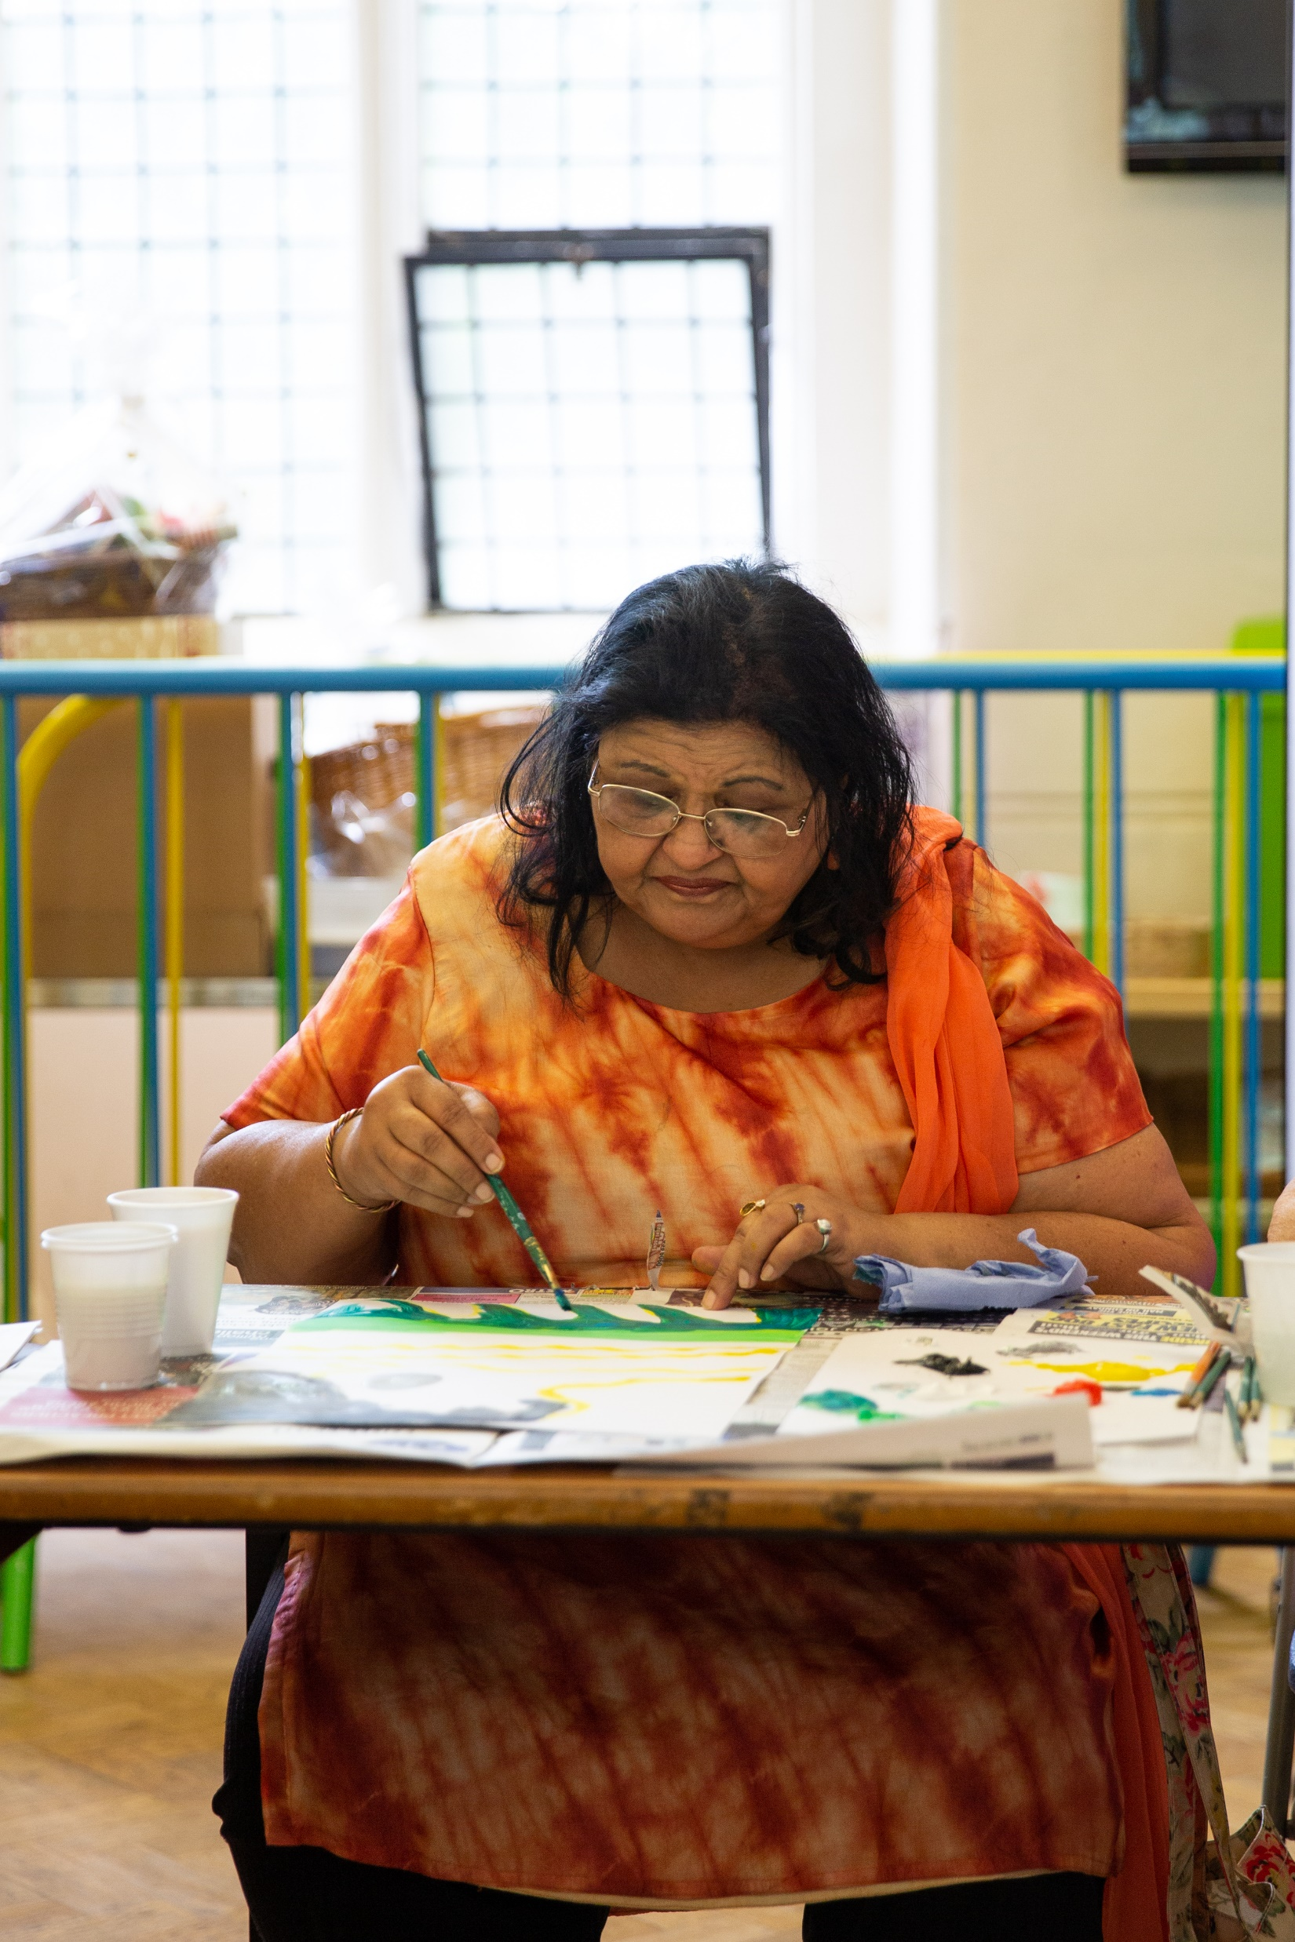
Decision Process
6 months decision time (main grants programme)
Online application – form and supporting documents
Full review by Funding Manager
Assessment visit or call if this is not possible
Charities Finance Team review
Decision
Public committee meetings

Slide 4
Who we fund
Registered charities
Registered Community Interest Companies (CICs)
Registered Charitable Incorporate Organisations (CIOs)
Charitable companies
Exempt or excepted charities
Registered charitable industrial and provident societies or charitable Community Benefit Societies (Bencoms)
Notes:
A charitable company refers to an organisation which is both a registered company (normally private company limited by guarantee) and a registered charity
Established for at least a year: able to provide at least one set of independently examined or audited accounts for a 12 month period

Slide 5
Who we can’t fund
Party political organisations
Charities registered outside the UK
Individuals
Schools, PTAs, other educational establishments
Hospitals and primary healthcare providers
Statutory bodies
For-profit organisations
Residential facilities

Slide 6
What we can’t fund
Party political campaigning/lobbying
Medical or academic research
Religious activities (e.g. proselytising)
Work that has already taken place
Festivals or events that last a few days or less
Residential activities/overnight stays
Residential care
Multiple concurrent grants to one organisation (with some exceptions)
Organisations within the “fallow period” after a previous grant or application

Slide 7
What you will need to provide with your application
Your governing document (i.e. your constitution)
Most recent signed accounts
(We will likely ask that you provide us with two further sets of financial information after you apply, e.g. draft accounts, management accounts, budget, or forecast)
Safeguarding policy
Fully costed budget
Monitoring framework
Notes:
Budget should cover the total cost of the work you are seeking funding for, and how much you are seeking from the Trust

Slide 8
How much can you apply for?
“Full cost recovery” – we will contribute to your overheads and core costs
Up to 5 years’ continuous funding
Up to 50% of your annual income per year
Minimum of the Real London Living Wage (currently £10.85/hr) for salaries
Up to 35 hours per week of salary costs
We can be the sole funder of a project or contribute to larger work
Average grant size for reopened funding strands available on website
Notes:
This applies to most of our programmes – otherwise will mention any other limits
Other support available have own restrictions on max amounts, such as… [next slide on accessible buildings]

Slide 9
Top tips
Read the website
Contact us if you need help understanding our criteria or if you have technical difficulties making an application
Show us how your work fits the criteria
You can add a document with additional information if useful (not required)
Don’t worry if your application is a better fit for a different programme than the one you applied under
We don’t need VIP treatment – funding is based on your work, eligibility, finances and governance
Notes:
This applies to most of our programmes – otherwise will mention any other limits
Other support available have own restrictions on max amounts, such as… [next slide on accessible buildings]

Slide 10
Funding programmes
now open
Notes:
In response to Covid-19, City Bridge Trust temporarily closed some of our programmes to new applicants, while we focussed on supporting our current funded organisations and the collaborative London Community Response, delivering emergency funding in support of the sector.
Following a review of our funding strands, many have now reopened.

Slide 11
Small Grants
Up to £10,000 per year for a maximum of 5 year for organisations with an income of less than £100,000:
greening and growing projects which bring communities together; and
projects which enable disabled people and/or disadvantaged, older people to actively participate in wellbeing opportunities
Notes:
Minimum term on lease

Slide 12
Transition Funding
Up to £50,000 per annum for up to 2 years in strands that remain under review:
Connecting the Capital
Voice and Leadership
Growing, greening and environmental projects
Arts, sports, health and wellbeing projects for D/deaf and disabled people or older people
Positive Transitions
Specialist support services for children and young people or older people
Mental health support for people experiencing homelessness or who are vulnerably housed
Notes:
Connecting the Capital
Some strands here are simplified or merged for space
We expect this fund to close mid May 2022, so recommend applying by the end of March

Slide 13
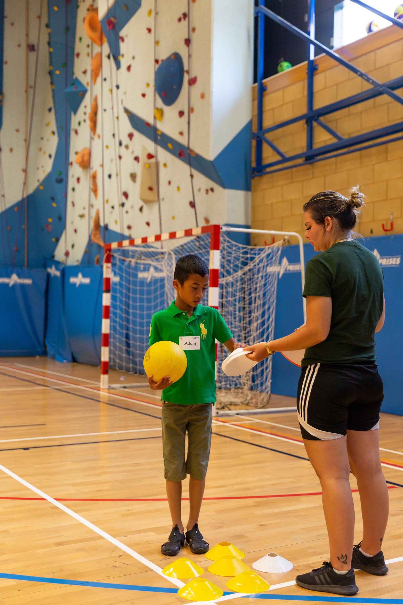
Support for refugees, asylum seekers and migrants
Work to tackle the barriers and providing access to resources. Such work can include:
mental and physical health support
provision of legal services
assistance with housing and educational needs
ESOL pre-entry (Level 3)
and much more…
Positive Transitions
Notes:
Positive transitions

Slide 14
Support and services for deaf and disabled people
Work to increase choice and control in the lives of disabled people such as:
Reducing or removing barriers to participation in society and independence
Influencing, raising voices, ensuring representation
We particularly welcome applications from Deaf and Disabled People’s Organisations (DDPOs)
We can’t fund where employment is the primary outcome
Positive Transitions
Notes:
Positive transitions
Definition includes people who are experiencing long-term mental health difficulties, learning differences or learning disabilities
DDPOS – definition on CBT website

Slide 15
Tackling abuse, exploitation and hatred
Work to prevent abuse, exploitation and hatred and to assist survivors, such as:
Support for survivors of all types of abuse (e.g. physical, sexual, emotional, financial, coercive control and neglect)
Work with perpetrators of abuse
Addressing modern slavery and trafficking
Tackling hate crime
Influencing, raising voices and ensuring representation
Positive Transitions
Notes:
Positive transitions
We want all Londoners to live safe lives with dignity and respect.
Work to tackle crime motivated by hostility based on race, religion, nationality, disability, sex, sexual orientation, or gender identity.

Slide 16
Building settled lives for those leaving custody or serving community sentences
Work that reduces the risk of further prison or community sentences, such as:
Preparing people for release from the custodial system
Supporting those reaching the end of community sentences
Evidence based alternatives to custody
Tackling inequalities in custodial sentencing
Positive Transitions
Notes:
Positive transitions
We are particularly interested to fund:
Work that informs and advises people of the services available to them on release
Work at specialist premises that support especially marginalised individuals, such as women who have survived domestic abuse
Safe and secure housing
Access to employment or self-employment opportunities
Facilities in Londoners/where beneficiaries are Londoners

Slide 17
Advice and support for disadvantaged people
We support work in the following areas:
Benefits
Debt and money
Fuel poverty
Employment problems
Housing
Immigration
An advice quality mark (e.g. AQS) is required for this strand.
Advice and Support
Notes:
Advice and Support
We can contribute to costs of advice accreditation

Slide 18
Food poverty
Support for work to facilitate the distribution of donated food.
We are particularly keen to hear from organisations working to ensure beneficiaries receive culturally appropriate food.
We aren’t able to directly fund the purchase of food.
Advice and Support
Notes:
Advice and Support

Slide 19
Place-based giving schemes
Place-based giving schemes bring people together from different sectors (voluntary, community, public and private) to build stronger communities and leverage community assets.
We can consider support for schemes that are part of the London’s Giving network and which commit to London’s Giving’s shared principles.
Connecting the Capital
Notes:
Connecting the Capital

Slide 20
Infrastructure funding: capacity and representation
Organisations which provide support to other voluntary, social enterprise and community sector organisations.
We are particularly keen to support organisations working with and/or who are led by groups that have historically faced barriers to accessing an equitable share of funding, resources, and other available support
Connecting the Capital
Notes:
Connecting the Capital

Slide 21
Access improvements to community buildings
Access Audits
Up to £5,000 for an independent access audit (provider must be NRAC registered or our partner the Centre for Accessible Environments)
Capital Access Grants
Up to £100,000 towards access improvements (where an access audit has already been completed)
Connecting the Capital
Notes:
Connecting the Capital
Minimum term left to run on lease
Building must be in Greater London

Slide 22
Eco audits
One of our approved eco audit consultants can assess your environmental performance. Depending on your organisation size and nature this can include:
Visiting your premises
Reviewing your energy and water use, travel, purchasing practices
Reviewing your policies
Raising awareness and training for staff
Connecting the Capital
Notes:
Minimum term on lease

Slide 23
Stepping Stones
Grants to development social investment readiness:
Capacity building grants – to enhance performance skills to deliver an organisation’s mission thereby enhancing investment readiness
Grants to pilot better outcomes – new ways of working, business models and partnerships, which should lead the organisation to use social investment for further development
Expected maximum of £50,000 or no more than 50% of an organisation’s income
Notes:
Minimum term on lease

Slide 24
What’s next?
More Bridging Divides funding strands to reopen in 2022
A new core funding offer
A new website
Ongoing “Funder Plus” (non-monetary support) for funded organisations, such as the Bridge Programme
Notes:
Minimum term on lease

Slide 25
Contact us
CityBridgeTrust@cityoflondon.gov.uk
020 7332 3710
citybridgetrust.org.uk
@CityBridgeTrust
Notes:
Minimum term on lease

