Slide 1
Health and wellbeing strategy supportingh information
Hammersmith & Fulham
2016
Gayan Perera
Senior Analyst,
Tri-borough Public Health,
Westminster City Council
gperera@Westminster.gov.uk

Slide 2
An Overview of different characteristics of local population
The borough at a glance…
80,600 | Households | 8 | Live births each day
£464,000 | Median house price | 2-3 | Deaths each day
182,500 | Residents | 11,900 | Local businesses
32% | From BAME groups | £33,000 | Annual pay
43% | Born abroad (2011 Census) | 3.1% | Unemployment rate (JSA) (London 3.1%)
23% | Main language not English | 22% | Local jobs in Public Sector
46% | State school pupils whose main language not English | Ranked 55th | Most deprived borough in England (out of 326) (13th in London)
17k/19k | Annual flows in and out of the borough | 29% | Children <16 in poverty, 2011 (HMRC)
198,900 | Registered with local GPs | Ranked 6th | Highest carbon emissions in London (not including City of London)
260,000 | Daytime population in an average weekday

Slide 3
Demography Summary
Population: 189,850 (GLA 2015)
Age GLA 2015)
  Children – 16.8% London - 20.0% | England 18.9%
  Working age - 73.9% London - 68.6% | England 63.2%
  Older people - 9.3% London - 11.4% | England 17.8%
% BAME (Census 2011) – 31.9%
London – 40.2% | England – 14.0%
% Not born in UK (Census 2011) – 42.6%
London – 36.7% | England – 13.4%
% English is first language of no one in household (Census 2011) – 14.5%
London – 12.9% | England – 4.3%

Slide 4
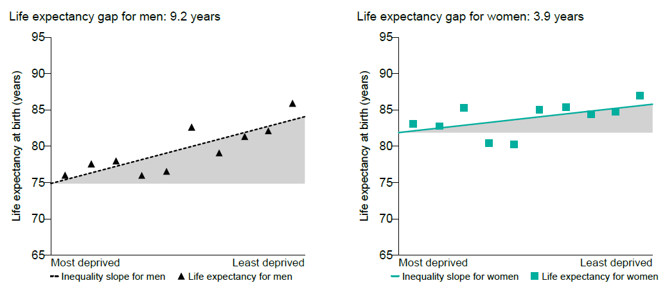
Life Expectancy
Source: PHE Public Health Profiles 2015
Notes:
The charts below show life expectancy for men and women in Hammersmith & Fulham for 2011-2013. Each chart is divided into deciles (tenths) by deprivation, from the most deprived decile on the left of the chart to the least deprived decile on the right. The steepness of the slope represents the inequality in life expectancy that is related to deprivation in this local area. If there were no inequality in life expectancy as a result of deprivation, the line would be horizontal.
Life expectancy for both men and women is similar to the England average. However, life expectancy is 9.2 years lower for men in the most deprived areas of Hammersmith and Fulham than in the least deprived areas.

Slide 5








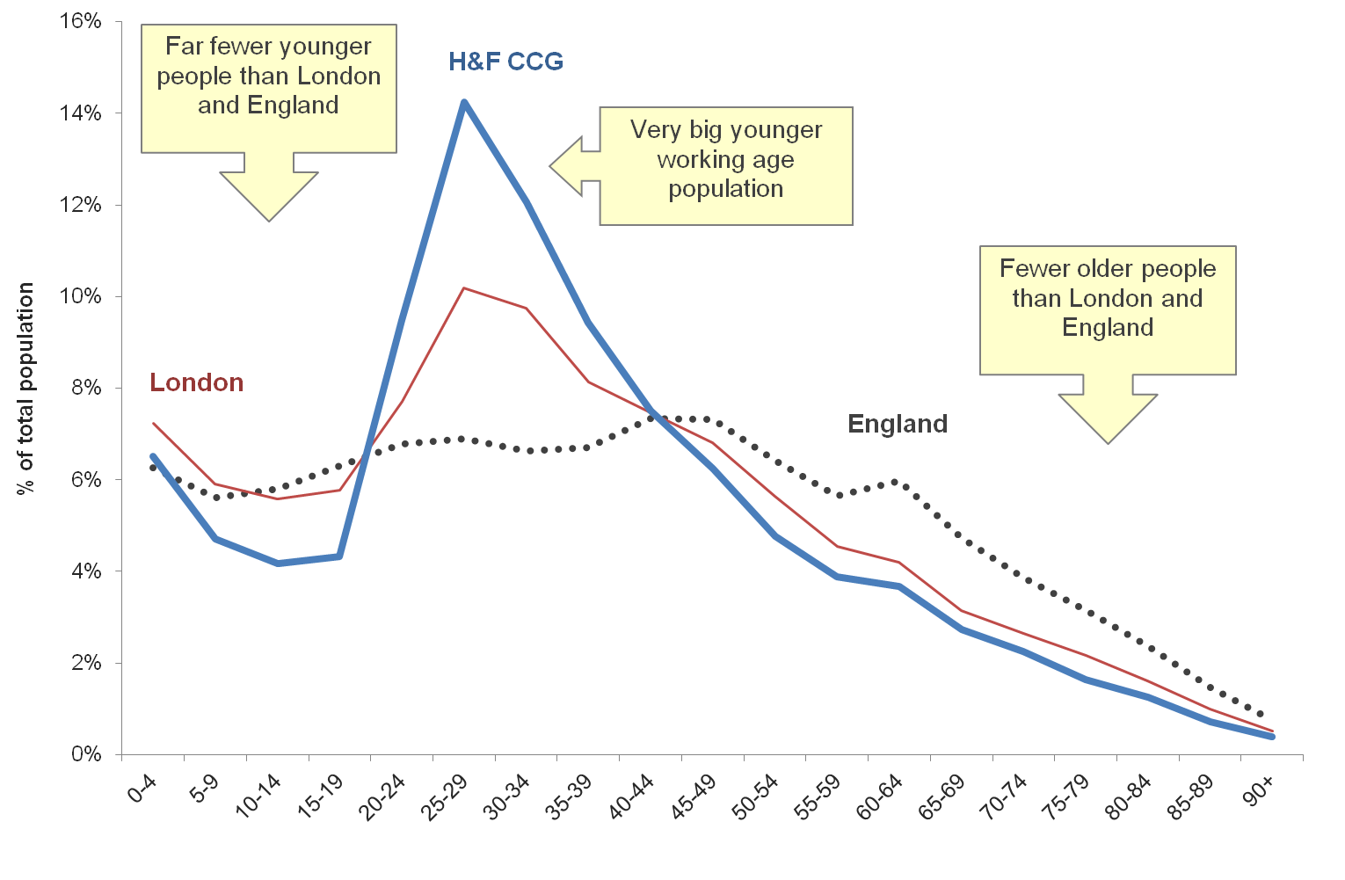

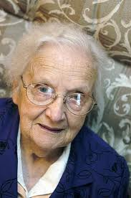
AGE
The area has a very high working age population compared to London). – Data collected universally across all sources.

Slide 6
Child Health
In Year 6, 22.4% (253) of children are classified as obese, worse than the average for England.
Levels of GCSE attainment, breastfeeding and smoking at time of delivery are better than the England average
Source: PHE Public Health Profiles 2015

Slide 7
Adult Health
13.3% of adults are classified as obese, better than the average for England. Estimated levels of adult excess weight and physical activity are better than the England average.
The rate of alcohol related harm hospital stays was 657*. This represents 938 stays per year.
The rate of self-harm hospital stays was 99.9*, better than the average for England. This represents 184 stays per year.
The rate of smoking related deaths was 350*, worse than the average for England. This represents 191 deaths per year. Estimated levels of adult smoking are worse than the England average.
Rates of sexually transmitted infections and TB are worse than average.
* rate per 100,000 population
Source: PHE Public Health Profiles 2015

Slide 8
Age | Health status | Healthcare access & quality
What do we know nationally? | Poorer health and chronic disease with age Greater levels of disability with age Around a third of 80+ year olds likely to have dementia Social isolation among older people Increasing depression among older people | Poorer dignity & respect in hospital for some older people Instances of lower operation rates for cardiac procedures among older population Younger people more likely to use A&E, not GP Lower cervical screening uptake for younger women
What do we know in H&F? | Poorer health and chronic disease with age Greater levels of disability with age High numbers of older people living alone – potential for social isolation Increasing depression among older people | Younger people more likely to use A&E, not GP Lower cervical screening uptake for younger women Older people have less success quitting smoking through local services (more long-term smokers?) Slightly worse access to psychological therapies Health Checks

Slide 9
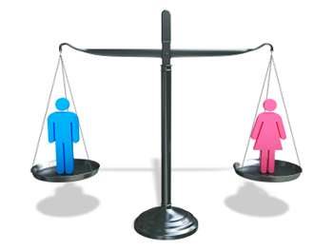

Gender
H&F area has a similar gender split to the rest of London and elsewhere in Great Britain, with the percentage of women being 1% greater and the percentage of men 1% lower .
Because women live longer than men, and the health inequalities between men and women, there are a much greater proportion of older women than older men among the H&F population.
Numbers for transgender and gender reassignment are not known locally.
Nationally, around 1500 people aged over 15 years old are presently undergoing treatment for gender dysphoria per year. There is also a rapid growth (15% per year) in the number of people, of all ages, who are seeking medical treatment for profound and persistent gender dysphoria.
H&F
52% 49%
London (2011 Census)
51% 49%
England (2011 Census)
51% 49%

Slide 10
Gender | Health status | Healthcare access & quality
What do we know nationally? | Shorter life expectancy for men Higher levels of smoking and low fruit & vegetable consumption among men Higher suicide rate among men Higher levels of substance abuse for men, including alcohol Higher common mental illness for women Lower levels of physical activity for women Violence against women Autism/ADHT higher among boys | Lower use of GP services by men Late presentation and diagnosis of cancer for men
What do we know in H&F | Same as above, although little information around lifestyles (outside Westminster) and violence against women | Smoking cessation among older smokers Late presentation for cancer
GAPS | Gender collected routinely, so good understanding of health status by gender Data no consistently available from General Practice | Good recording of gender, but lack or routine analysis around level of access across range of services commissioned

Slide 11

Number of Family Breakdowns
Little data is gathered around the number of family breakdowns and adoptions in the CWHH s area. The 2011 Census identifies 10.3% of the local adult population as separated or divorced, which is lower than the London and national averages
The number of divorces in England and Wales in 2011 was 117,588, a decrease of 1.7% since 2010 , when there were 11,589 divorces
In 2011, 10.8% people divorced per thousand married population compared with 12.9% in 2001.
The number of divorces in 2011 was highest among men and women aged 40 to 44. Based on marriage, divorce and mortality statistics for 2010, it is estimated that the percentage of marriages ending in divorce is 42% compared with 45% in 2005.
The number of adoptions in England and Wales in 2011 was 4,734, an increase of 6 per cent since 2010 when there were 4,481 adoptions.
In 2011, most children adopted (62%) were aged between one and four years, rising from 58% in 2010.
The percentage of children adopted who were born outside of marriage increased slightly to 82% in 2011, up from 80% in 2010.

Slide 12

Race Ethnicity and nationality
2001 Census data Ethnicity
2011 Census data Ethnicity
 | H&F area | London
White British | 58% | 60%
White Other | 20% | 11%
Black | 11% | 11%
Asian | 5% | 13%
Other/Mixed | 6% | 5%
BME | 22% | 29%
 | H&F area | London
White British | 45% | 45%
White Other | 23% | 15%
Black | 12% | 13%
Asian | 9% | 18%
Other/Mixed | 11% | 8%
BME | 32% | 40%
In the 10 years between the 2001 and 2011 Censuses, the percentage of people in black and minority ethnic groups has increased by 10% in H&F and 11% in London.
There has been a particular increase in the ‘other ethnic’ group in H&F, which may be partly a result of the creation of the ‘Arab’ category. The Asian group has increased due to a rise in ‘Other Asian’. There has also been a rise in the ‘White other’ group. The numbers in the black ethnic group have remained relatively static
Note: Chinese grouped under ‘Asian’ in 2001 to be comparable to 2011

Slide 13
Race/ ethnicity | Health status | Healthcare access & quality
What do we know nationally? | Poorer life expectancy for Pakistani/ Bangladeshi groups Greater susceptibility to diseases such as diabetes for Asian and Black groups Issues around refugee/asylum seeker health Low birth weight babies among some groups e.g. Asians Low physical activity/ high smoking for some groups e.g. Asians | BME groups disproportionately using emergency services over routine/ GP services and some experience of challenges communicating with health professionals Gypsies & travellers more likely to use emergency services over routine services Black groups more likely to be detained under mental health act
What do we know in H&F? | Poorer health among certain ethnic groups, from 2011 Census Smoking rates high for Eastern European groups in Westminster Issues around female genital mutilation for some Somali and Sudanese women Speech and language therapy more common among BME children | Conflicting evidence around breast and cervical screening uptake – lower uptake in some groups Gaps in local knowledge around gypsies & travellers High ‘did not attend’ rates among some ethnic groups for hospital services
GAPS | Ethnic group not recorded on death certificates, hence some lack of local understanding of ill health by ethnicity GP data not consistently available Data not always collected accurately | Sometimes poor data collection GP data not consistently available Small numbers in groups means methodological challenges around ‘proving’ access issues

Slide 14






Religion and Belief
 | Christian % | Muslim % | Hindu % | Jewish % | Buddhist % | Sikh % | Other religion % | No religion % | Religion not stated %
H&F | 54.1% | 10.0% | 1.1% | 0.6% | 1.1% | 0.2% | 0.5% | 23.8% | 8.4%
London | 48.4% | 12.4% | 5.0% | 1.8% | 1.0% | 1.5% | 0.6% | 20.7% | 8.5%
England | 59.4% | 5.0% | 1.5% | 0.5% | 0.5% | 0.8% | 0.4% | 24.7% | 7.2%
According to the 2011 Census data, 54% of the population in H&F were Christian, higher than London (48%) but lower than England. A far smaller proportion of the H&F population were Hindu, Jewish or Sikh compared to the London average

Slide 15
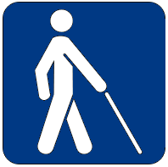


Disability
Limiting Long-term illness (LLTI), 2011:
Estimated 25,000 patients stated they had a LLTI
(12.6% of the population of H&F (London: 14.2%))
Visual Impairment:
840 registered blind or partially sighted.
(According to NHS statistics 2011)
Learning Disabilities:
385 on GP learning disability registers
(0.19% of the H&F GP population)
Working Age Disability:
Est 6,000 economically inactive due to long-term sickness or disability
(3.9% of working age population (London 3.7%))
Using a Mobility Aid:
Est 4,900 aged 65 or over using an aid.
(based on national population prev of around 29%)
(HSE 2005)).
Hearing Impairment:
350 registered deaf or hard of hearing.
(According to NHS statistics 2014).
Those of working age with a disability are more likely to be living in areas of social housing.
Disability among older people is likely to rise due to improved life expectancy and ageing of post war baby boom.
Improved life expectancy at birth and better hospital care means increase in numbers with complex needs living in adulthood.
Limited information collected on patient disability.

Slide 16
Disability | Health status | Healthcare access & quality
What do we know nationally? | Low life expectancy and high rates of obesity, heart conditions for those with learning disabilities Mental health one of the primary causes of disability Those with chronic diseases more likely to have a common mental illness Working age disabled people twice as likely to be out of work and claiming benefits as non-disabled people | Low rates of screening for learning disability population and ‘diagnostic overshadowing’
What do we know in H&F? | High rates of incapacity benefit for mental health reasons in deprived parts of INWL Working age disability more likely in areas of social housing and deprivation (according to 2011 Census) | Some evidence of low rates of screening and health checks for learning disability population Limitations around accessibility of home care, given restrictions on adaptations to some housing (due to conservation area planning rules) Challenges around accessibility and DDA compliance of primary care estate and restrictions to adapting premises Low numbers on hearing and sight registers, compared to likely number in local population

Slide 17


Sexual orientation
Little data is gathered around sexual orientation in the CWHH s area. According to Stonewall, the size of the lesbian and gay population in the country may be in the region of 5-7% of the population. The Inner North West London area has among the highest rates in the country for HIV transmitted through sex between men, with very high rates in surrounding areas suggesting that the gay population may be larger than elsewhere.
According to the 2011 Census, Hammersmith and Fulham has the 14th highest proportion of residents in same sex civil partnerships in the country (Westminster has the 6th highest and K&C has the 7th highest)
Nationally, lesbian, gay, bisexual and transgender (LGBT) groups are more likely to experience mental health problems and self-harm, as well as being more likely to engage in lifestyles harmful to health, such as drinking smoking and drug use. Locally the area is noted for a higher than average level of sexually transmitted diseases and a very high level of HIV transmission via sex between men.
Nationally issues have been highlighted around a lack if trust and/or understanding between LGBT groups and health professionals. National research has shown that 4 out of 10 men have not disclosed their sexuality to their GP. Local knowledge is restricted as data is not routinely collected around sexual orientation.

Slide 18
Sexual orientation | Health status | Healthcare access & quality
What do we know nationally? | LGBT groups more likely to experience mental health problems and self-harm More likely to engage in lifestyles harmful to health (e.g. drinking, smoking, drug use) | Issues around lack of trust/understanding between LGBT groups and health professionals
What do we know in H&F? | Very high levels of HIV acquired through sex between men High levels of sexually transmitted diseases | Good access to HIV clinics locally

Slide 19
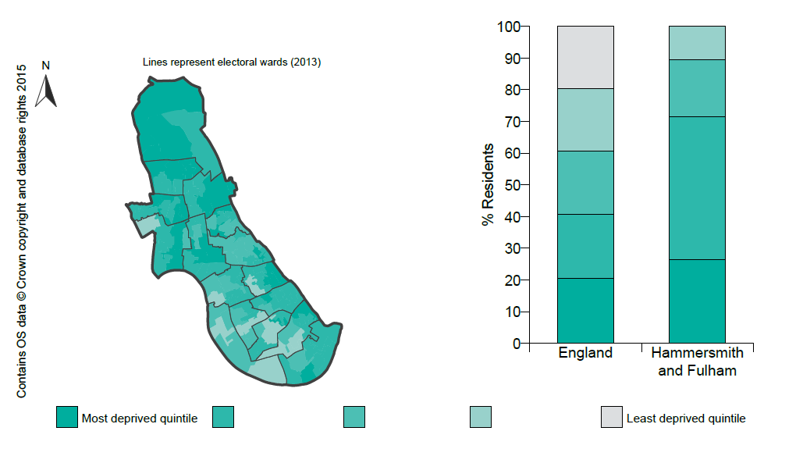
Deprivation
Source: PHE Public Health Profiles 2015
Notes:
Deprivation in Hammersmith & Fulham is higher than the England average and about 25.6% (7,600) children live in poverty.
The map shows differences in deprivation in Hammersmith & Fulham based on national comparisons, using quintiles (fifths) of the Index of Multiple Deprivation 2010, shown by lower super output area. The darkest coloured areas are some of the most deprived neighbourhoods in England. There are high levels of deprivation in the Northern wards.
The chart on the right shows the percentage of the population who live in areas at each level of deprivation. More than 70% of the population live in areas which are either the most deprived or second most deprived quintiles.

Slide 20
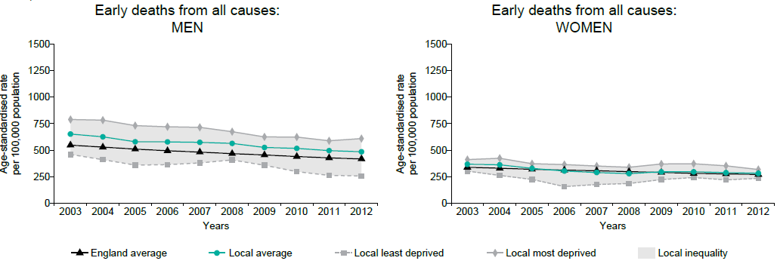
Health Inequalities – Trends (I)
Source: PHE Public Health Profiles 2015
Notes:
The charts provide a comparison of the changes in early death rates (in people under 75) between Hammersmith & Fulham and all of England. For men in Hammersmith & Fulham the rates are worse than England in 2011-2013 but women are similar to England in the same time period.
Early deaths from all causes also show the differences between the most and least deprived quintile in this area. Mortality rates from causes considered preventable are higher in more deprived groups compared to the least deprived groups.
(Data points are the midpoints of 3 year averages of annual rates, for example 2005 represents the period 2004 to 2006).

Slide 21
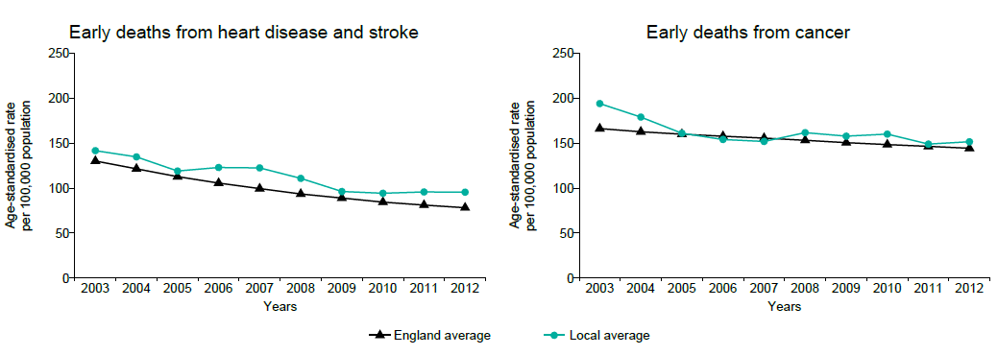
Health Inequalities – Trends (II)
Source: PHE Public Health Profiles 2015
Notes:
Under 75 mortality from cardiovascular diseases is higher than the England average.
Under 75 mortality from cancer is similar to the England average.

Slide 22
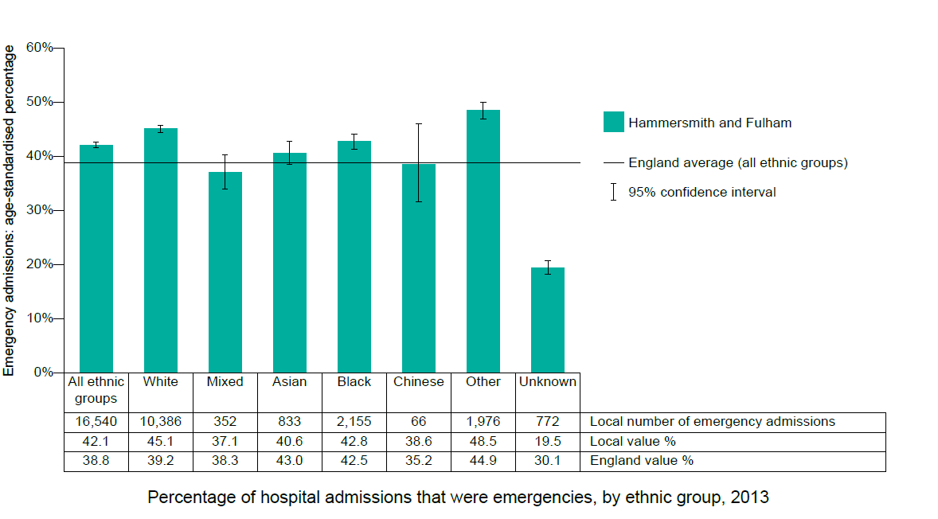
Health Inequalities – Ethnicity
Source: PHE Public Health Profiles 2015
Notes:
This chart shows the percentage of hospital admissions for each ethnic group that were emergencies, rather than planned.
A higher percentage of emergency admissions may be caused by higher levels of urgent need for hospital services or lower use of services in the community. Comparing percentages for each ethnic group may help identify inequalities.

Slide 23
Socio-economic status | Health status | Healthcare access & quality
What do we know nationally? | For lower socioeconomic status: Inequality in terms of life expectancy. Much greater burden of chronic disease More likely to smoke and less likely to eat fruit & vegetables or take regular exercise Higher levels of common mental illness | More frequent use of healthcare services (partly due to poorer health) More likely to use A&E over GP, compared to more affluent groups Greater ‘did not attend’ rates
What do we know in H&F? | Large inequality in terms of life expectancy. See previous chart Much greater burden of chronic disease More likely to smoke and less likely to eat fruit & vegetables or take regular exercise (based on Major Health Campaign in Westminster) | Evidence of ‘inverse care law’ in the past, where poorer quality services are located in poorer areas. No longer necessarily an issue Greater ‘did not attend’ rates

Slide 24
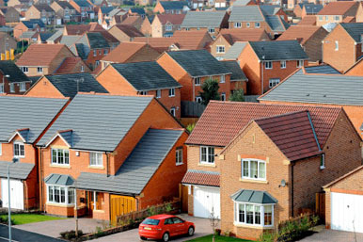
Housing
A third of people (34%) live in private rented housing – the 5th highest in London – and a similar proportion (35%) are owner occupiers – the 8th lowest in London. Just under a third (30%) live in social housing, which is more than is typical of London.
Thirty eight per cent of households are one person households, higher than nationally. One in 10 households (8.8%) is a lone pensioner household, lower than London (9.6%) and England. Almost half (43%) of older people live alone, carrying a risk of social isolation.
Pressure on social housing stock and property prices in London has resulted in overcrowding, particularly among families. Across all tenures, a similar proportion of households (13%) are considered to be overcrowded, compared to London (12%).

Slide 25
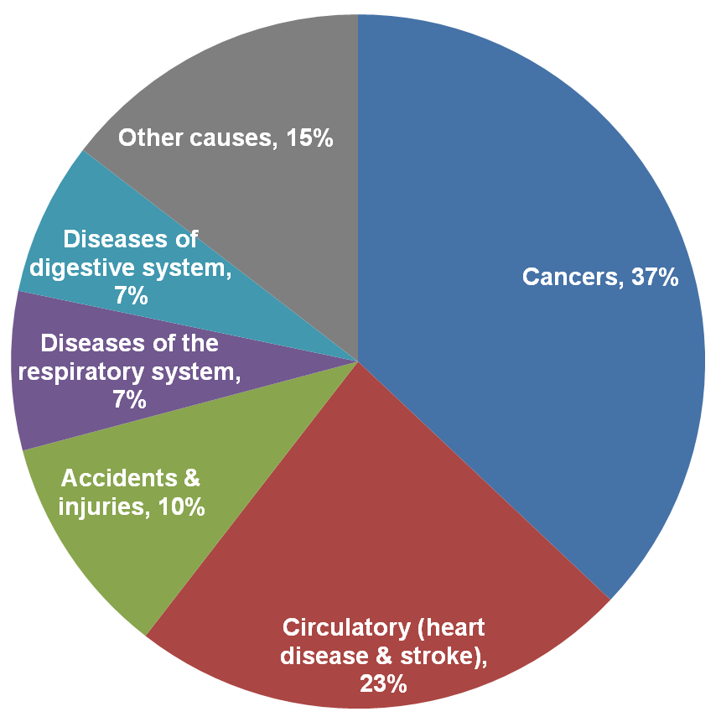
Patterns of ill health
  The principle cause of premature death in Hammersmith and Fulham is cancer, followed by cardiovascular disease (CVD) (which includes heart disease and stroke). A significant number of people also die from respiratory disease. Accidents and injuries are most common among younger residents. This is pattern is broadly similar to the rest of the country.

Slide 26
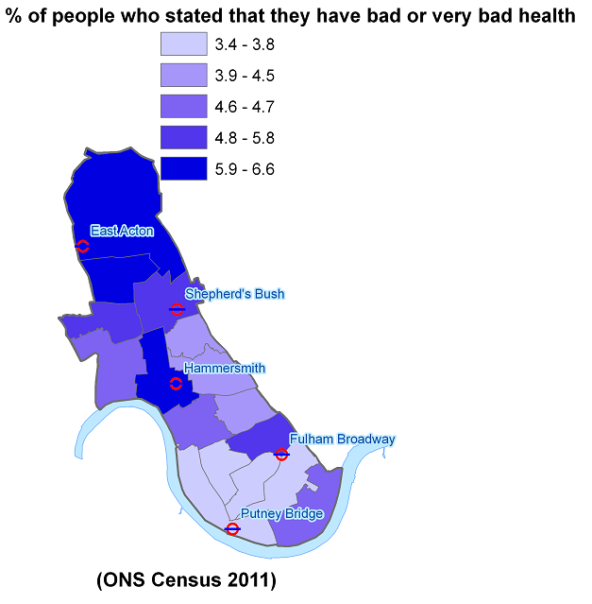
Vulnerable Groups in London Borough of Hammersmith and FULHAM
The overall premature (under 75) death rate higher than London and England and Shepherd’s Bush Green, Askew, and Hammersmith Broadway wards fall within the 20% worst wards in London, with around 7-11 more early deaths a year than is typical for London. Furthermore, residents in those wards have stated that their health is either bad or very bad in the last census

Slide 27
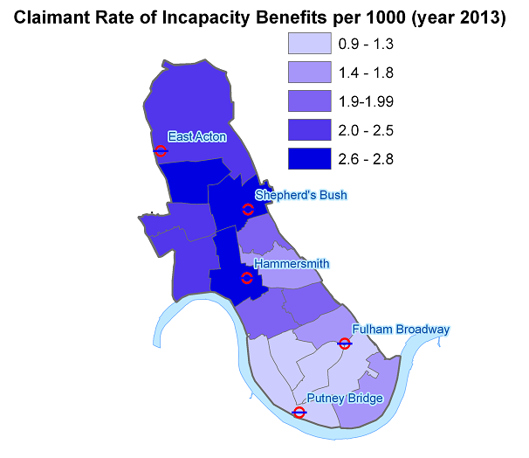
Serious Mental illnesses
There are currently 2,395 patients in the borough on a GP register for severe and enduring mental illness (e.g. schizophrenia), the 8th highest in the country. These patients are spread relatively uniformly throughout the borough. Incapacity benefit claimant rates due to mental health and other medical reasons are high in Shepherd’s Bush, Wormholt & White City and Hammersmith Broadway

Slide 28
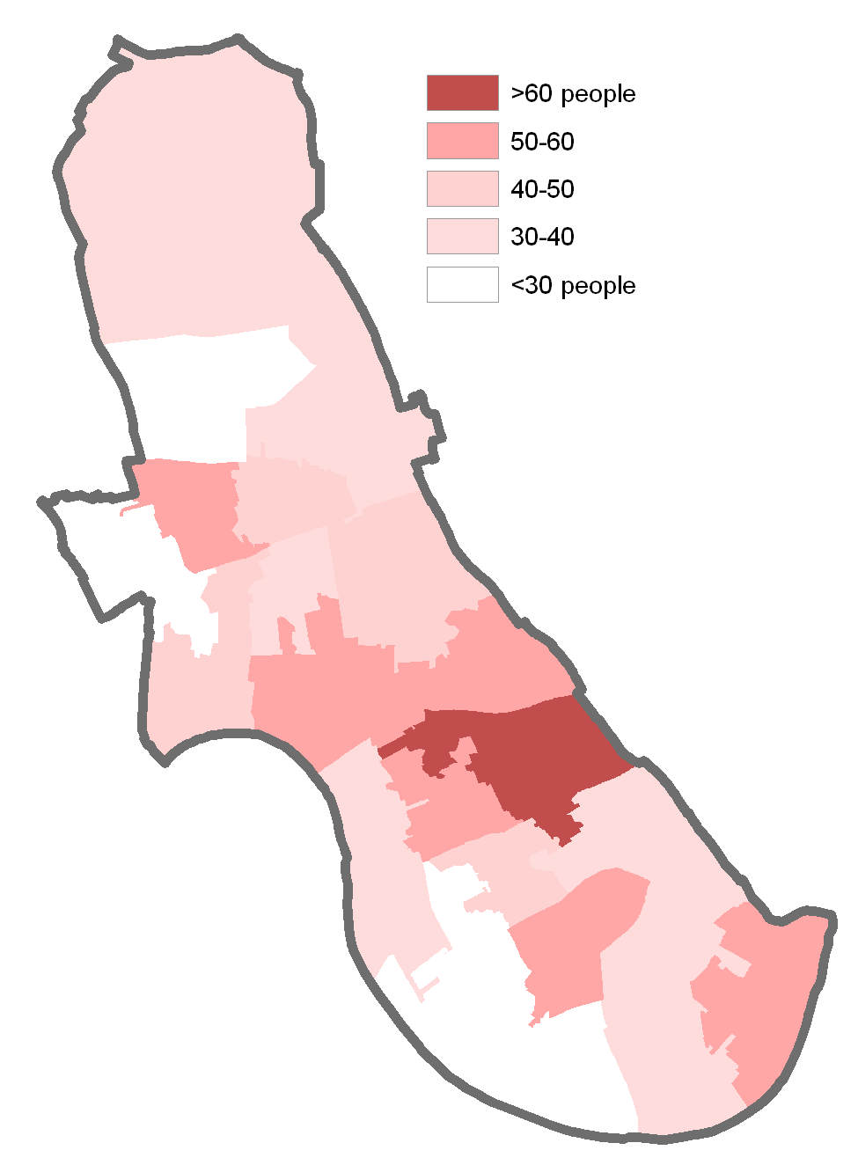
HIV
There are currently 1,051 residents in Hammersmith and Fulham diagnosed with HIV, the 7th highest rate aged 15-59 in the country, with a higher proportion of cases contracted via sex between men.
19% of cases were diagnosed late, compared to the London average of 27%. Late diagnosis carries with it increased risk of poor health and death and increases chances of onward transmission.
High rates of HIV/ AIDs patients known to services are residing in North End ward

Slide 29
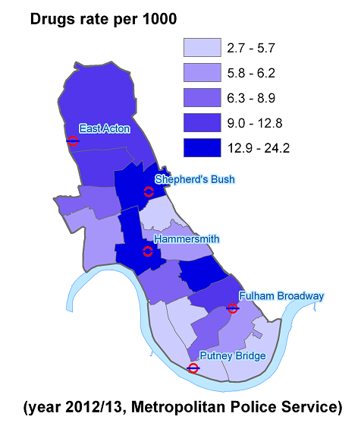
problem drug users
The estimated number of problem drug users in Hammersmith and Fulham was 1,450, a rate of 11.5 per 1,000 population aged 15-64, the 9th highest rate in London. The cost to society of crimes associated with problem drug use in the borough may be as much as £60 million, (based on national estimates from the Home Office).Drugs offence rate per 1000 is high among Shepherd’s Bush, Hammersmith Broadway and North End wards

Slide 30
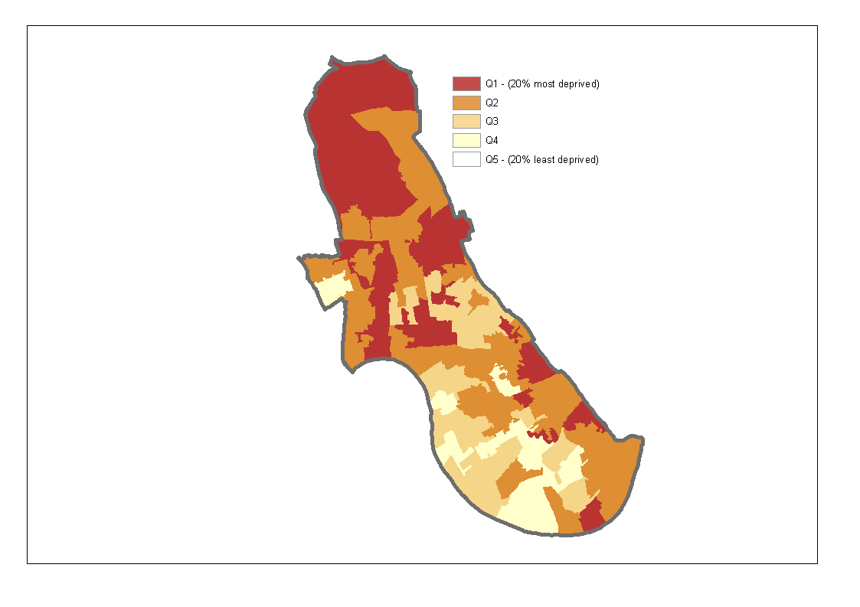
Deprivation
Hammersmith and Fulham was classified as the 55th most deprived borough in the country according to the index of multiple deprivation, which is based on a range of economic, social and housing indicators. Pockets of deprivation are spread throughout the borough but are particularly focussed in the north of the borough. These areas usually correspond to areas of social housing and poorer than average health.
A third of children under 16 (29%) live in poverty according to official definitions, which is higher than London and England. The Job Seekers Allowance rate in H&F are similar to London (3.1%) and Great Britain (2.9%), but rates are almost double this in areas such as College Park & Old Oak and Wormholt & White City.

Slide 31
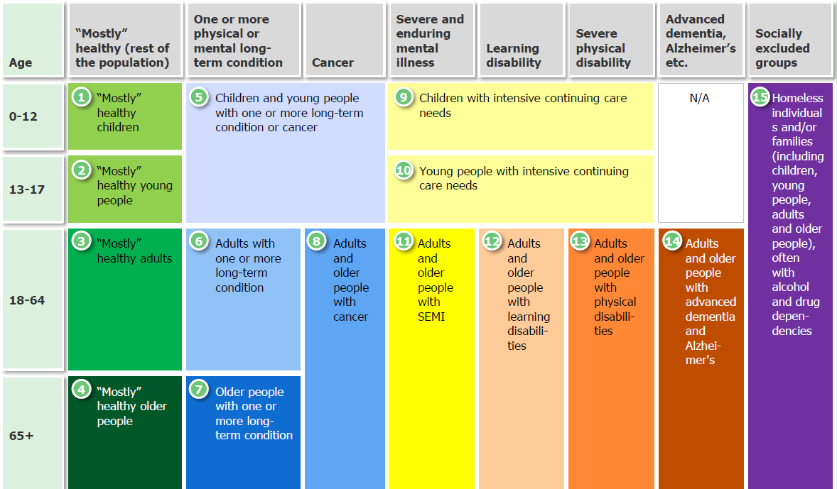
Number and percentage of the population in each group, LBHF 2015
Health group
25,800
600
0
Unknown
14%
0%
7,000
10
4%
0.3%
0%
108,700
17,700
1,400
1,200
500
1,700
400
Age
60%
10%
6,500
9,600
4%
5%
1%
1%
0.3%
1%
0.2%
Healthy
82%
Unhealthy
18%

Slide 32
Percentage change in the number in each group and trend, LBHF 2015 - 2025
Health group
+4%
+12%
0
Unknown
+11%
+5%
+3%
+11%
+17%
+8%
+12%
+10%
+15%
Age
-1%
+16%
Healthy
82%
Unhealthy
18%
Notes:
The groups include the trendline of the number in each group from 2015 to 2030

Slide 33
Number in each group, LBHF 2015 - 2025
Health group
2015: 25,800
2020: 27,000
2025: 26,600
2015: 600
2020: 650
2025: 700
2015: 0
2020: 0
2025: 0
Unknown
2015: 7,000
2020: 7,700
2025: 9,100
2015: 10
2020: 10
2025: 10
2015: 108,700
2020: 112,300
2025: 114,200
2015: 17,700
2020: 19,700
2025: 21,700
2015: 1,400
2020: 1,600
2025: 1,800
2015: 1,200
2020: 1,300
2025: 1,400
2015: 500
2020: 600
2025: 650
2015: 1,700
2020: 1,800
2025: 2,000
2015: 400
2020: 400
2025: 500
Age
2015: 6,500
2020: 6,400
2025: 7,000
2015: 9,600
2020: 11,100
2025: 12,500
Healthy
82%
Unhealthy
18%

Slide 34
Average annual cost of health care services per person in each group, London 2012/13
Health group
£1,520
£3,400
£8,750
Unknown
£860
£8,080
£735
£2,300
£11,800
£22,000
£57,300
£38,000
£19,300
Age
£2860
£3,910
Healthy
80%
Unhealthy
20%

Slide 35
Total annual cost of health care services in each group in millions , LBHF 2015
Health group
£39M
£2M
£0M
Unknown
£6M
£0M
£80M
£41M
£16M
£27M
£30M
£64M
£7M
Age
£18M
£37M
Healthy
82%
Unhealthy
18%

Slide 36
Changing Patterns of Need
  Child obesity in Hammersmith and Fulham state primary schools has been consistently higher than nationally for Year 6 pupils (aged 10-11) over a period of time. These higher rates may in part be a result of physical inactivity and poor diet, which is also reflected in poorer than average levels of tooth decay locally. In 2010/11, 158 children in reception and 275 children in year 6 were found to be at risk of obesity (BMI 95th percentile) and 99 and 188 were classified as clinically obese (BMI 98th percentile). 10% of the borough’s primary school children live outside the borough.
  Alcohol-related harm is an increasing public health issue and Hammersmith and Fulham is an ‘outlier’: it has more hospital admissions for alcohol-related and specific harm (e.g. liver disease) and alcohol-related crimes than the national average. Over the last decade, alcohol-related admissions have more than doubled, faster than nationally. ‘Hotspots’ for alcohol-related admissions include the White City and Shepherd’s Bush area.
  The number of older people is expected to rise considerably over the next two decades. Although the rise experienced locally may not be as substantial as the rise nationally, it will nevertheless have a dramatic impact on demand for services. At the same time, the number of those providing unpaid care in Hammersmith and Fulham was the 4th lowest in the country in 2001.
  Illnesses such as dementia, primarily prevalent among very old populations, will become increasingly commonplace. Currently, there are likely to be around 1,250 patients in Hammersmith and Fulham with dementia. By 2025, there are likely to be in the region of 1,500 patients. Earlier diagnosis of dementia is associated with delayed admission to nursing care.

Slide 37
Projections of prevalence of selected diseases in H&F
Year | CMD | CVD | COPD | Dementia | Hypertension | Cancer
2015 | 25,464 | 13,259 | 5,807 | 1,249 | 36,841 | 4,659
2020 | 25,576 | 13,900 | 6,088 | 1,386 | 38,665 | 5,392
2025 | 25,847 | 14,733 | 6,409 | 1,579 | 40,661 | 6,316
2030 | 26,310 | 15,744 | 6,803 | 1,817 | 43,024 | 7,446
CMD= Common Mental Disorders
CVD= Cardiovascular Diseases
COPD= Chronic Obstructive Pulmonary Disorder

